Slide 1
Statement :: portal for addrressal and solution for social issues

Slide 2
ABSTRACT :-
We see many social problems in our daily life around us ,
eg: broken roads which needs repair , not glowing streetlights
etc.. Which are to be solved within a limited time ,but are not these days .
Even the complaints registered officially take a lot of time to get solved because of improper addrresal to correct ministry .

Slide 3
ABSTRACT:-
The problems are first collected from victimized people through their post in our portal .. The post contains a form with their genuine details ( validation is done), the problem statement attached with pictures and clips of the incident .
This information sent to the respective ministry (govt. or private) for obtaining the solution or physical response(servvice) .
If the problem is not solved for ages... It will be highlighted and posted in the social media for further processing

Slide 4
USE CASES TEXT :-
tion : a web application that collects social issues posted by people and analyse and post the issue to the repective ministeries .
Name: portal for addrressal and solution for social issues
Brief Descrip
Actors : public , respective ministeries
Actors : public , respective ministeries

Slide 5
TECHNOLOGY STACK:-
Html
Css
Javascript
Django
Database(sqlite)

Slide 6
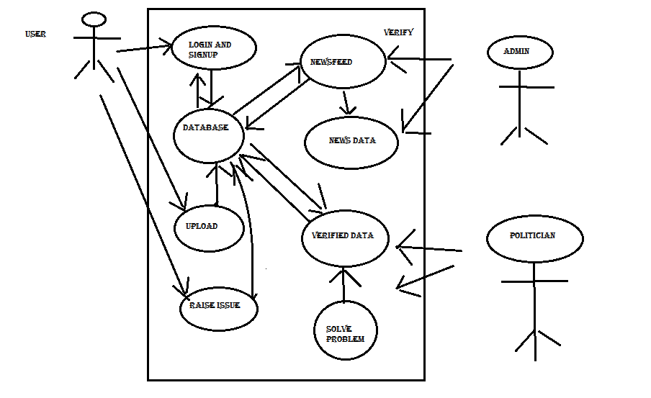
USE CASE DIAGRAM:-
Html
Css
Javascript
Django
Database(sqlite)

Slide 7
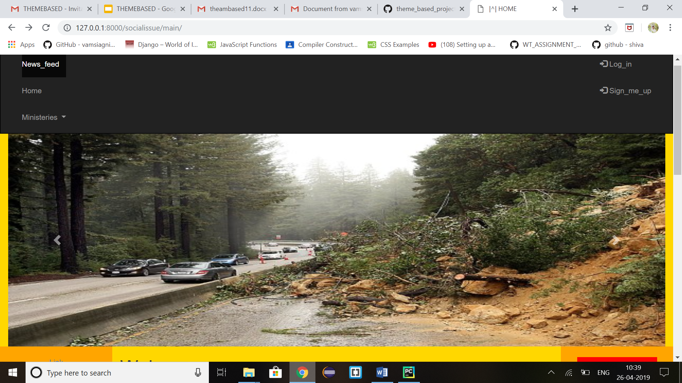
RESULT

Slide 8
conclusion
AS WE KNOW GOVERNMENT NEGLECT IN SOLVING PROBLEMS IN OUR SOCIETY.
SO THE MAIN MOTTO HERE IS PRIVATIZE THE WORK SO THAT GOVERNMENT HAVE SOME PRESSURE FROM PEOPLE AND FROM NGOS THAT MAKES PROBLEM SOLVE.

Slide 9
FUTURE WORKS
WE WANT TO AUTOMATE THE VERIFICATION BY AI AND DEEP LEARNING
WE WANT TO IMPLEMENT COMPLAINT BOX FOR NOT SOLVED PROBLEMS
TO MAKE INVOLVE DIFFERENT ORGANISATIONS FOR SOLVING PROBLEMS

Slide 10
THANK YOU
DONE BY ::
Vamsi . Agnihotram
Kannam . Shiva kumar

